Slide 1


FTMBA2 M2 - Innovation Culture
Individual Project
Natalia Voskoboinikova

Slide 2

From Labor Constraints to 24/7 Predictable Freight
This presentation explores the transformative potential of Level-4 autonomous freight trucks in the Russian long-haul logistics sector, focusing on innovation, value creation, and practical implementation.
We will delve into the challenges faced by the industry today, outline how hub-to-hub autonomy offers a viable solution, and present a clear roadmap for its safe and effective deployment.

Slide 3






The Current Model is Hitting Structural Limits
Driver Shortage & Aging Workforce
HOS Limits & Low Utilization
A persistent lack of drivers and an aging demographic strain operational capacity.
Hours-of-Service regulations restrict truck utilization to only 50-60%, impacting efficiency.
Safety & Fatigue Risks
Rising Operating Costs
Human error and driver fatigue contribute to safety incidents on long hauls.
Increasing payroll, fuel, and theft risks elevate operational expenditures.
Low ETA & OTIF Predictability
ESG Pressures
Unpredictable transit times and on-time delivery rates hinder supply chain planning.
Growing demand for sustainable and environmentally responsible logistics practices.
The current model of long-haul freight in Russia faces escalating challenges that are becoming structural limitations. These pain points are not isolated but interconnected, creating a complex web of inefficiencies and risks. Incremental fixes will no longer suffice; a transformative solution is required to address these systemic issues and ensure the long-term viability and competitiveness of the Russian freight ecosystem.

Slide 4
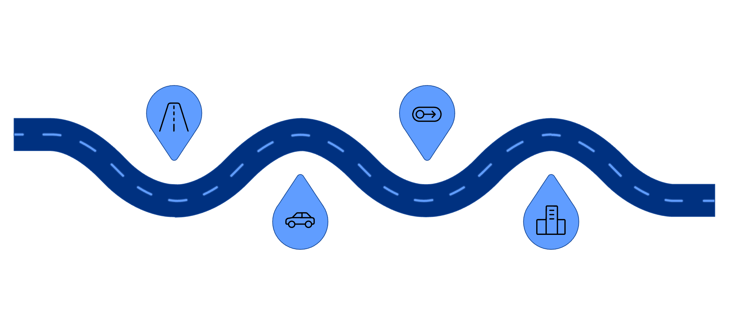




L4 Autonomy Works When the Domain is Controlled
Control Transition
Highway ODD
Designated hub-to-hub corridor for L4
Hand-off to human or teleoperator at boundary
Autonomous Zone
Non-ODD Areas
Truck operates self-driving within corridor
City limits or depot require manual control
Level-4 autonomy means the vehicle drives itself completely within a defined Operational Design Domain (ODD).
Our focus: hub-to-hub trunk corridors on designated highways, excluding last-mile delivery.
Outside the ODD, control transitions to a teleoperator or a safe stop is executed.
This controlled environment makes L4 autonomy practical and safe for long-haul routes.
The experimental legal regime in Russia, extended to 2028, supports these AV pilots.
Understanding the Operational Design Domain (ODD) is critical for grasping Level-4 autonomy. It defines the specific conditions under which an autonomous driving system is designed to function safely. For long-haul freight, this means designated highway corridors between logistics hubs. By clearly defining these boundaries, we can ensure the autonomous system operates within its tested capabilities, making the solution both practical and inherently safer. The Russian regulatory environment is conducive to these developments, offering a window of opportunity for piloting these solutions.

Slide 5
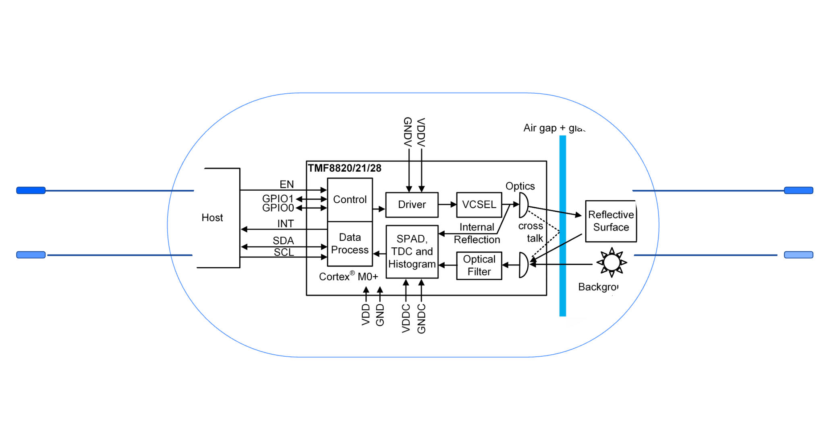
A Hybrid System: Autonomy + Teleoperations + Safety Redundancy
Autonomy Stack
Sensors
Lidar, Radar, Cameras feed perception
Perception, planning, control fusion
Truck Operations
Teleoperations
Remote assistance and intervention
Vehicle actuation and route execution
Advanced sensor suite (lidar, radar, cameras) feeds the autonomy stack for real-time perception.
High-definition maps and Vehicle-to-Everything (V2X) communication ensure contextual awareness.
Remote teleoperations provide human oversight for edge cases and unexpected scenarios.
Redundant safety systems are integrated to ensure fail-operational capabilities.
Operational layer integrates with Transport Management (TMS) and Warehouse Management Systems (WMS).
Cybersecurity is embedded from design, protecting against evolving threats.
This solution is more than just an autonomous truck; it's a sophisticated operating system for freight. The combination of cutting-edge hardware and intelligent software, supported by human teleoperators for complex situations, creates a robust and reliable system. Seamless integration with existing logistics platforms and a proactive cybersecurity posture are vital to ensure operational efficiency and trust. This holistic approach ensures not just autonomous driving, but autonomous freight management.

Slide 6

Safety and Reliability are Engineered, Proven, and Monitored
Simulation & Closed-Course Testing
Rigorous virtual and physical testing validates system performance under controlled conditions.
Real-World Pilots on Limited Routes
Phased deployment on specific corridors to gather data and refine operations in live environments.
Safety Case & Certification Path
Developing a comprehensive safety argument for regulatory approval and transparent certification.
Incident Evidence & Reporting
Establishing transparent mechanisms for reporting and learning from all operational events.
Stakeholder Alignment
Collaborating with regulators, road operators, emergency services, and insurers to build consensus.
Process Innovation Methods
Leveraging Design Thinking, Lean/Six Sigma, and Agile pilots for continuous improvement.
Safety is paramount and engineered into every stage of development and deployment. We follow a methodical approach from simulation to real-world validation, ensuring that autonomous operations meet the highest safety standards. This includes building a robust safety case for certification, transparently reporting all incidents, and fostering strong alignment with all stakeholders. A continuous learning loop is integrated to adapt and improve based on real-world data and feedback, ensuring that reliability is not just a feature, but a fundamental outcome.

Slide 7
From Driver-Dependent Variability to Data-Driven Predictability
Safety Incidents
Higher due to human fatigue/error
Significantly lower, AI-driven consistency
Cost Structure
High payroll, variable fuel/theft losses
Reduced payroll, optimized fuel, lower theft
Utilization
50-60% due to HOS limits
Up to 90%+, 24/7 operations possible
Lead Time Predictability
Lower, subject to human factors
High, consistent speeds and routes
Reliability/Visibility
Moderate, real-time tracking varies
High, continuous monitoring & precise routing
Theft Risk Exposure
Moderate to high, cargo vulnerability
Reduced, enhanced security protocols
This table starkly illustrates the transformative shift from traditional human-driven logistics to Level-4 autonomous operations. The biggest deltas lie in utilization, safety, and predictability. Autonomous trucks can operate continuously, maximizing asset use and significantly reducing the risks associated with human factors. The inherent predictability and transparency of autonomous systems will fundamentally change how freight is planned, executed, and delivered, leading to unparalleled efficiency and reliability across the supply chain.

Slide 8






Value Creation Across Cost, Safety, Service, and ESG
↑ 30-40%
↓ 25-35%
Utilization Increase
Cost/Ton-Km Reduction
Maximize asset uptime for continuous operations.
Lower operational costs through efficiency and optimized resource use.
↓ 80-90%
↑ 95%
Incidents/Km Decrease
ETA/OTIF Reliability
Significantly enhance safety by mitigating human error.
Boost on-time delivery and estimated time of arrival accuracy.
↓ 50-70%
↓ 15-20%
Theft-Related Losses
CO2/Ton-Km Reduction
Reduce cargo vulnerability with advanced security and monitoring.
Achieve environmental benefits through optimized driving and routing.
These target ranges represent significant gains across all key performance indicators, reflecting the estimated impact of L4 hub-to-hub autonomy. It's important to note that these are estimates to be validated in pilots, with initial gains focusing on utilization and safety. Full economic impact, especially cost reduction, will scale with broader adoption. The overall value proposition extends beyond direct financial savings, encompassing enhanced safety, superior service levels, and improved environmental performance, aligning with modern ESG goals. Each KPI will be rigorously tracked and used as a go/no-go gate for subsequent phases of deployment.

Slide 9
Adoption Succeeds Only If Risks Are Actively Managed
Regulation & Liability
Joint frameworks, safety case development, active insurer engagement.
Regulators, Insurers
Infrastructure Readiness
Targeted corridor upgrades, V2X deployment, road operator partnerships.
Road Operators, Government
Cybersecurity Threats
Layered security architecture, continuous monitoring, robust incident response, industry standards.
Tech Providers, Cybersecurity Experts
Public Trust & Workforce Impact
Transparency, public demos, reskilling programs, new role creation (teleoperators, data engineers).
Public, Unions, Training Institutions
The successful adoption of Level-4 autonomous freight depends heavily on proactive risk management. Each identified risk has a clear mitigation strategy embedded in our design and implementation plan. This isn't an afterthought; it's a foundational element of the project. Engaging with key partners—from regulators to road operators and insurers—is essential to co-create solutions and build a framework of trust and shared responsibility. By openly addressing these challenges, we pave the way for a safer, more efficient, and publicly accepted autonomous freight ecosystem.

Slide 10
Phased Rollout with Measurable Go/No-Go Gates
Phase 1: Pilot (2024-2025)
Phase 3: Industrialize (2028+)
Limited corridors, safety metric validation, initial regulatory approvals, unit economics proof-of-concept.
Commercial integration, market acceptance, full economic impact realization, continuous improvement.
1
2
3
Phase 2: Scale (2026-2027)
Expand routes/fleet, full regulatory and certification, ops readiness (teleops + TMS/WMS), cybersecurity maturity.
Our roadmap outlines a strategic, phased approach to introducing autonomous freight, ensuring careful progression based on validated successes. Each phase is defined by clear go/no-go gates that serve as critical decision points, ensuring that we only advance when safety, operational efficiency, and economic viability are proven. The "experimental legal regime extended to 2028" provides a crucial window for the initial pilot and scaling phases, allowing us to gather necessary data and achieve key milestones within a supportive regulatory environment.

Slide 11
This is a Business Model Shift—Not Just Automation
Regulators
Collaborate on safety frameworks and liability models.
Shippers/Carriers
Participate in pilots, redefine logistics processes, integrate L4 data.
Tech Providers
Focus on robust, reliable, and secure AV technology development.
Insurers
Develop new risk assessment models and coverage options.
Road Operators
Identify and prepare critical corridors for AV deployment.
The shift to Level-4 autonomous freight is fundamentally about redesigning the entire logistics value chain, moving beyond mere automation. It involves transforming existing professions, creating new roles like teleoperators and data engineers, and fostering new interaction models across the ecosystem. To accelerate this transition, we urge all stakeholders to actively engage: regulators in defining clear frameworks, shippers and carriers in piloting new operational models, and road operators in preparing the necessary infrastructure. Join us in shaping the future of Russian long-haul freight.

